Slide 1


Number System Emulator
Experiment 2
Raphael S. Nano
CPE160P / B1
Computer Engineering Department
School of Electrical, Electronics, and Computer Engineering

Slide 2
Introduction: Number Systems
It is defined as a system of naming or representing numbers
May be decimal, binary, octal, or hexadecimal
Conversion is essential in the relationship between machine and human language

Slide 3
Objectives
To be able to demonstrate how Arduino Kit will be used to emulate conversion between number systems
To be able to apply embedded system in number system conversion using LEDs, Seven-segment display, and switches.
To be able to apply what you have learned in Microprocessor and Logic Circuits and Switching Theory.
To be able to apply embedded system in a simple handshaking using Arduino Kit.

Slide 4
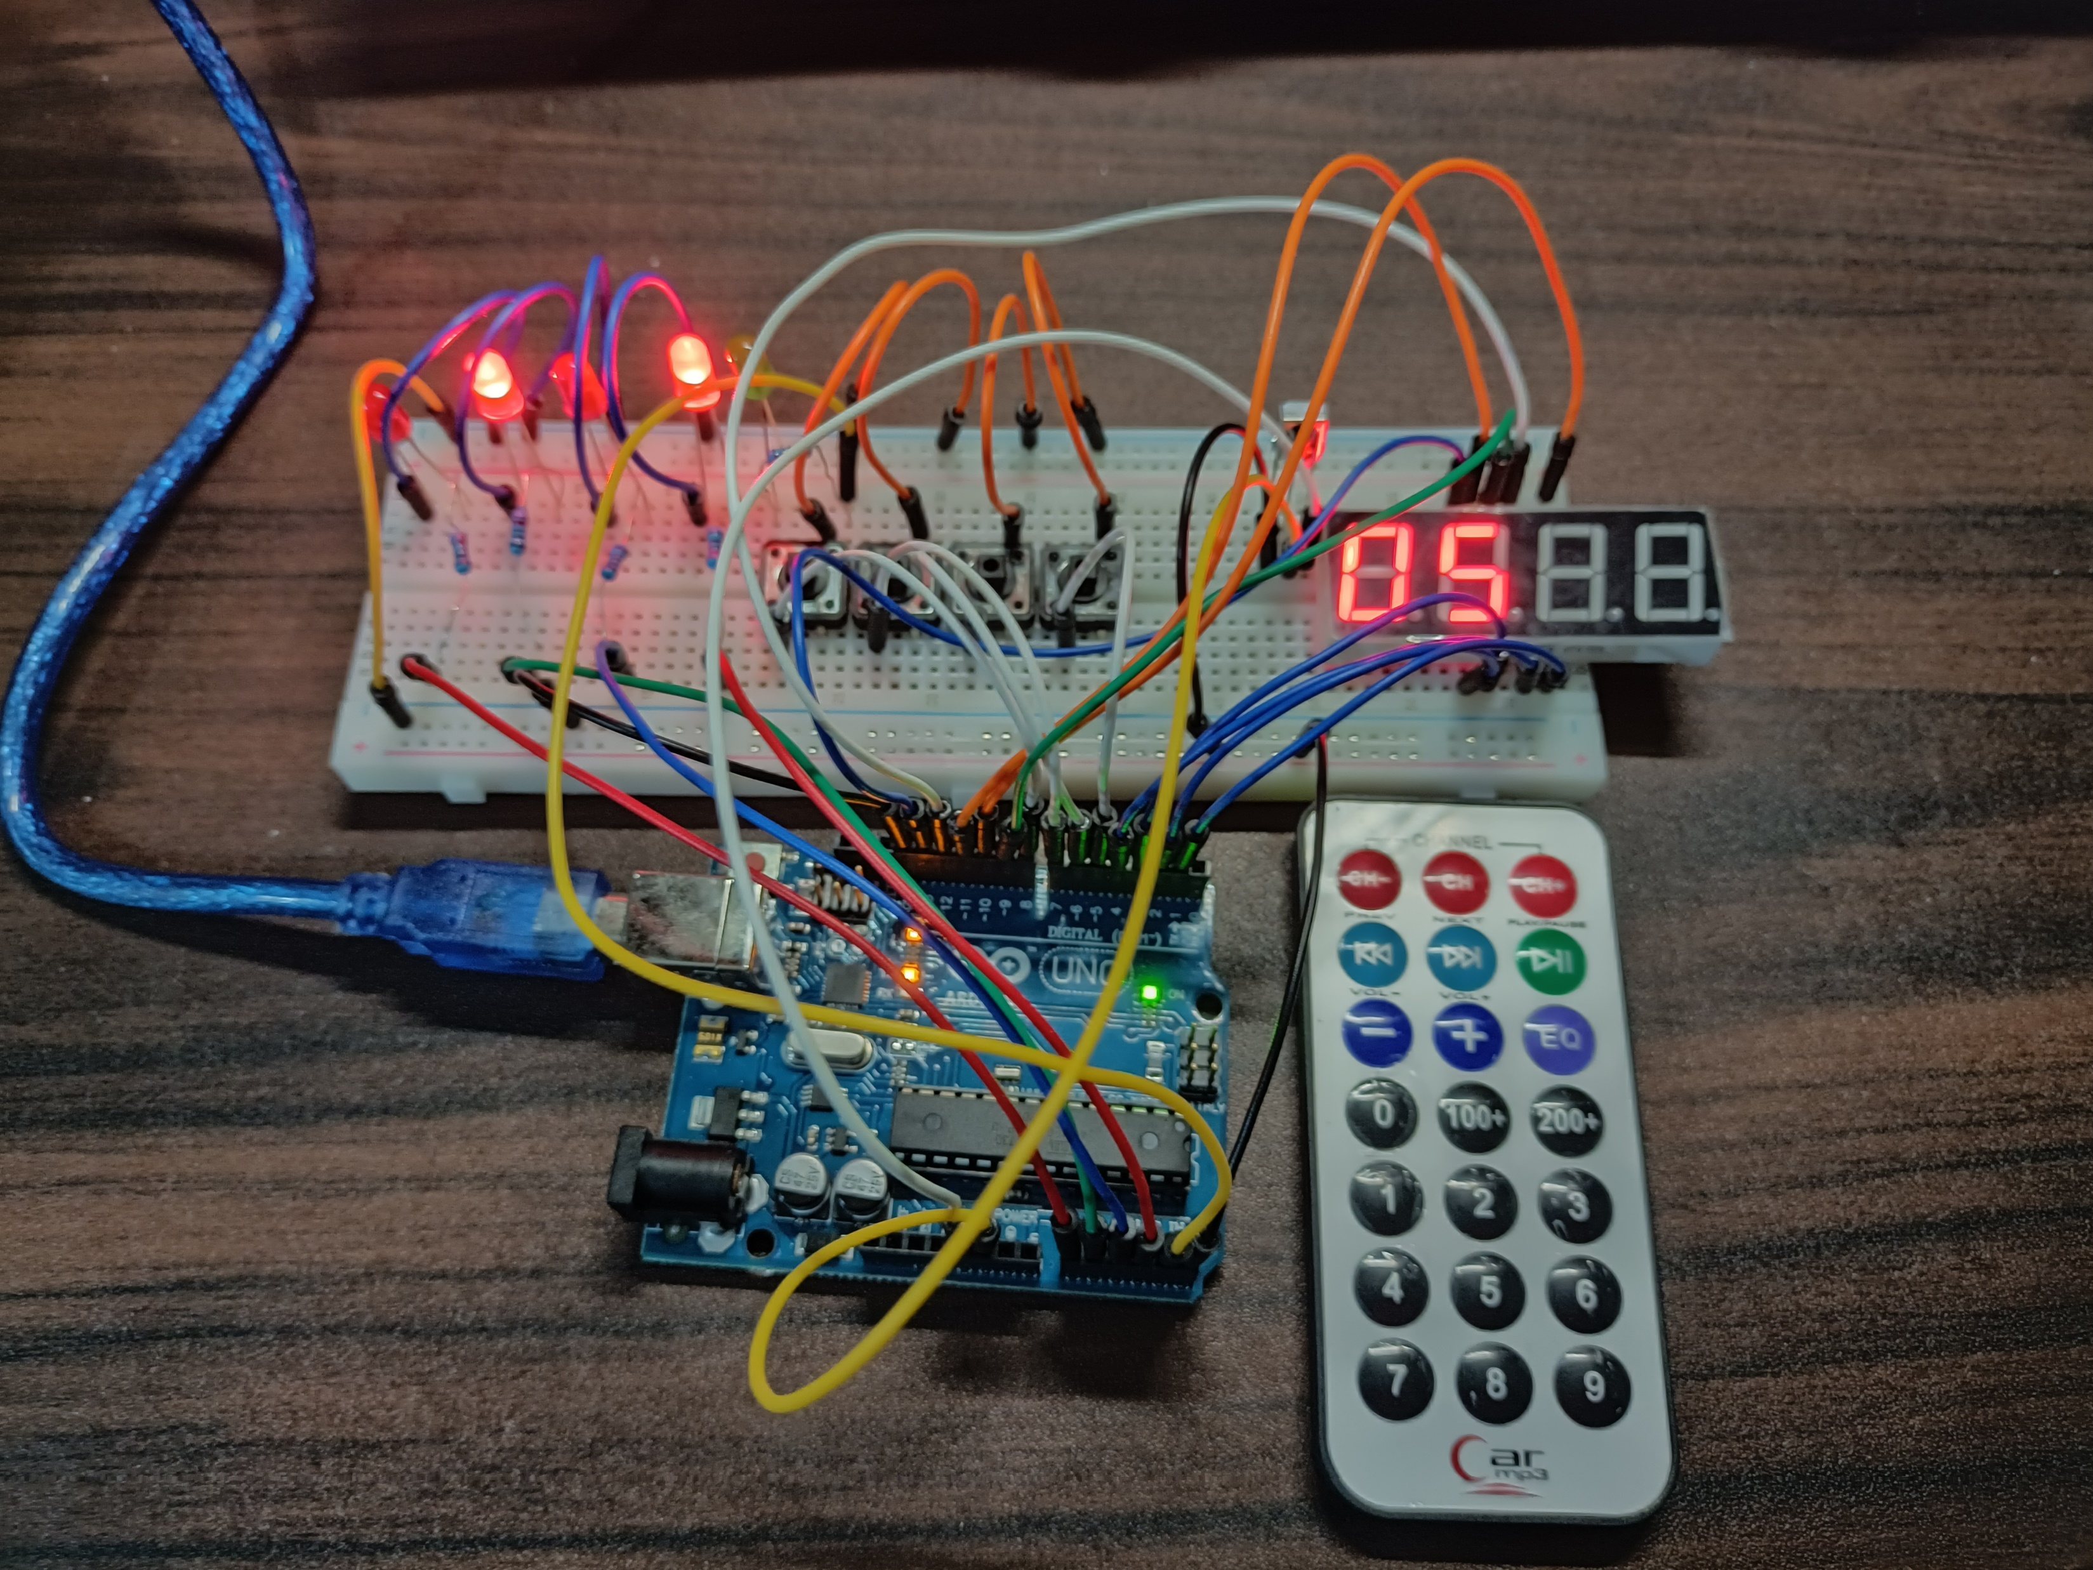
Materials
Arduino Kit
Arduino Uno
5 LEDs
4 Switch Buttons
1 Infrared receiver sensor
1 Infrared remote
1 4-Digit seven segment display

Slide 5
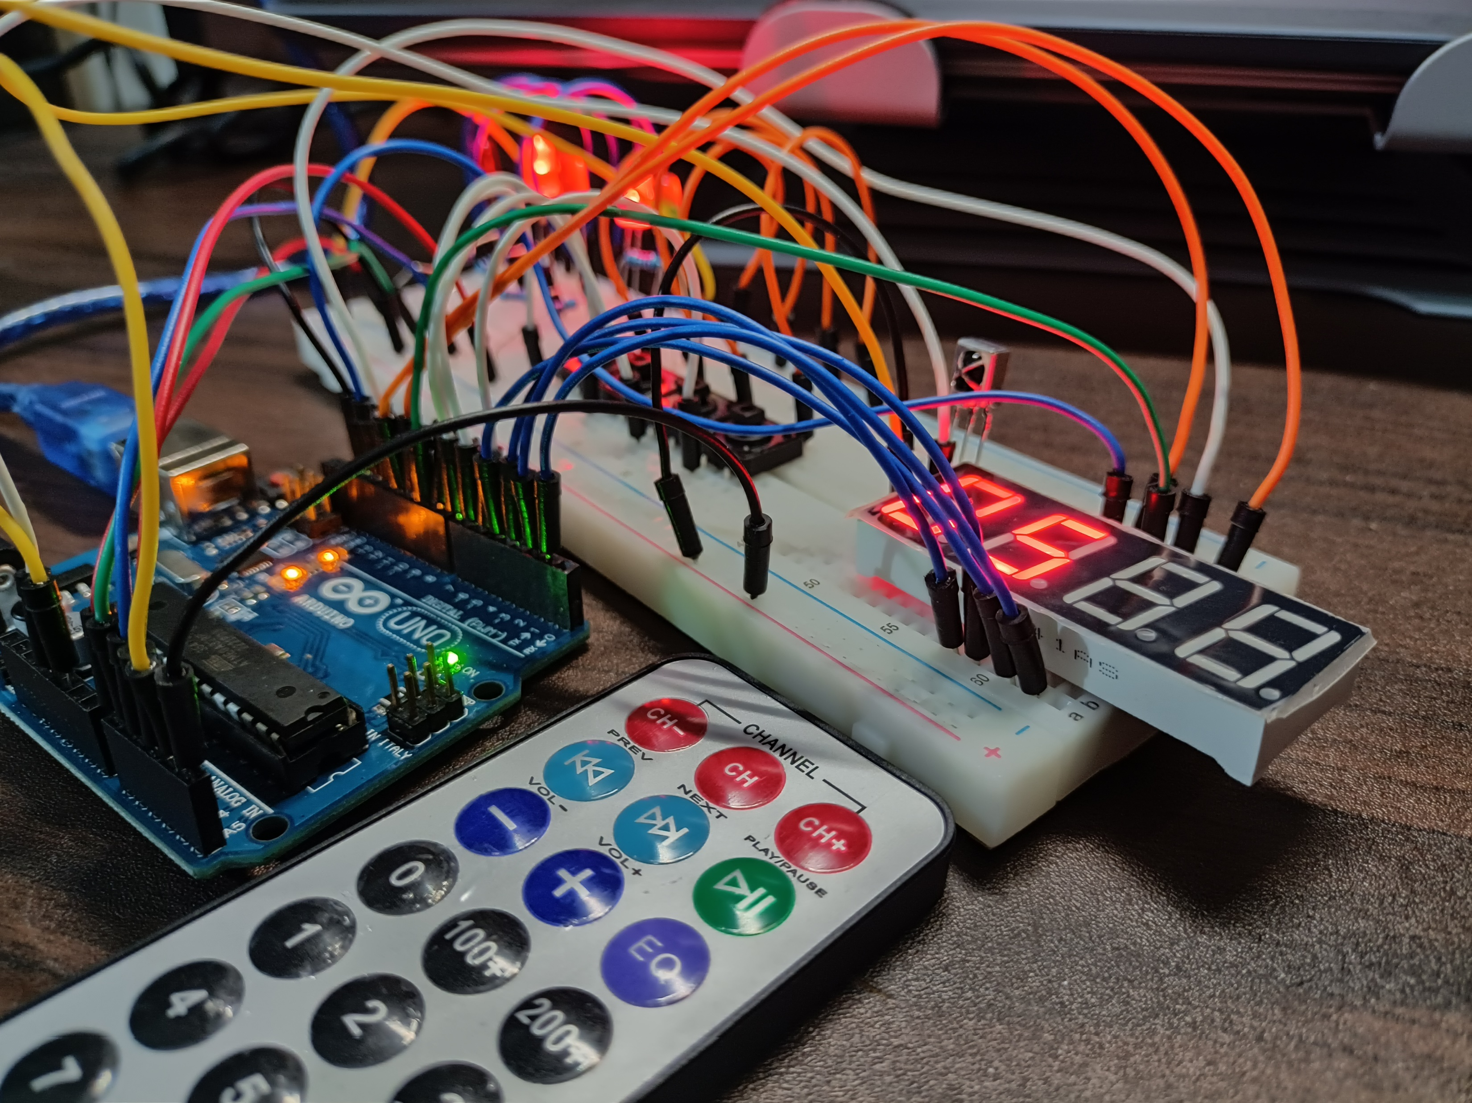

Discussion: Decimal to 4-Bit Binary
There are two parts: Decimal to 4-bit binary and 4-bit binary to its excess-5 in decimal form
Inputs are numbers 0-9 in the IR remote; Output is decimal in 7-segment display
Decimals on 7-segment display is converted to 4-bit binary
External libraries (SevSeg.h and IRremote.h) were utilized
“analogWrite” was used for LED states
“switch case” was used in determining the number

Slide 6
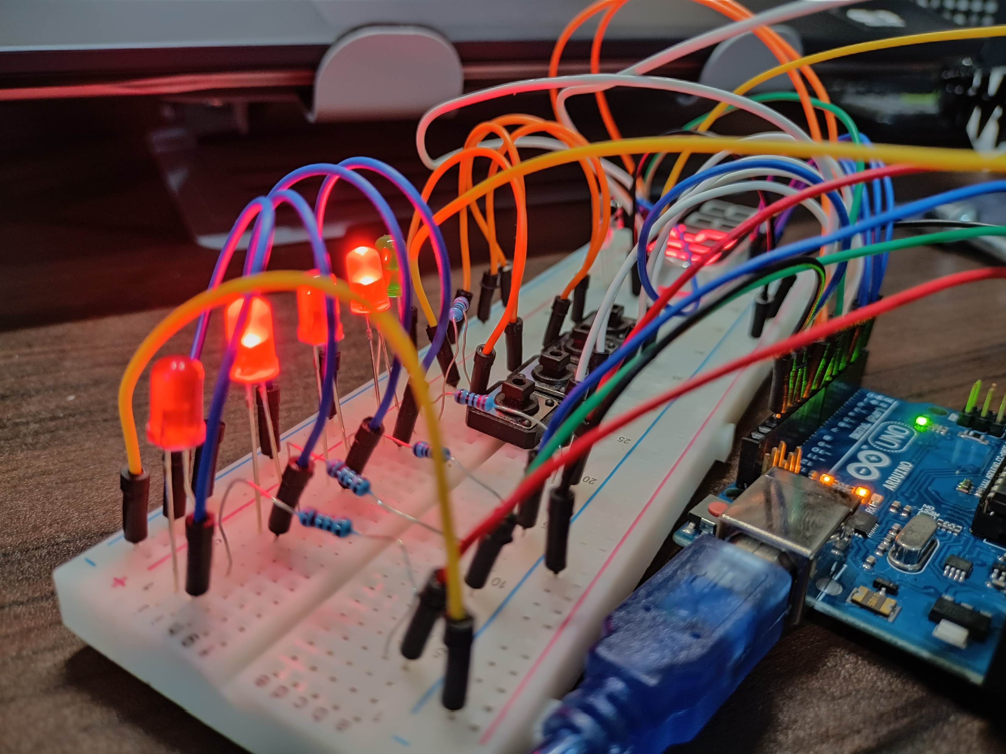
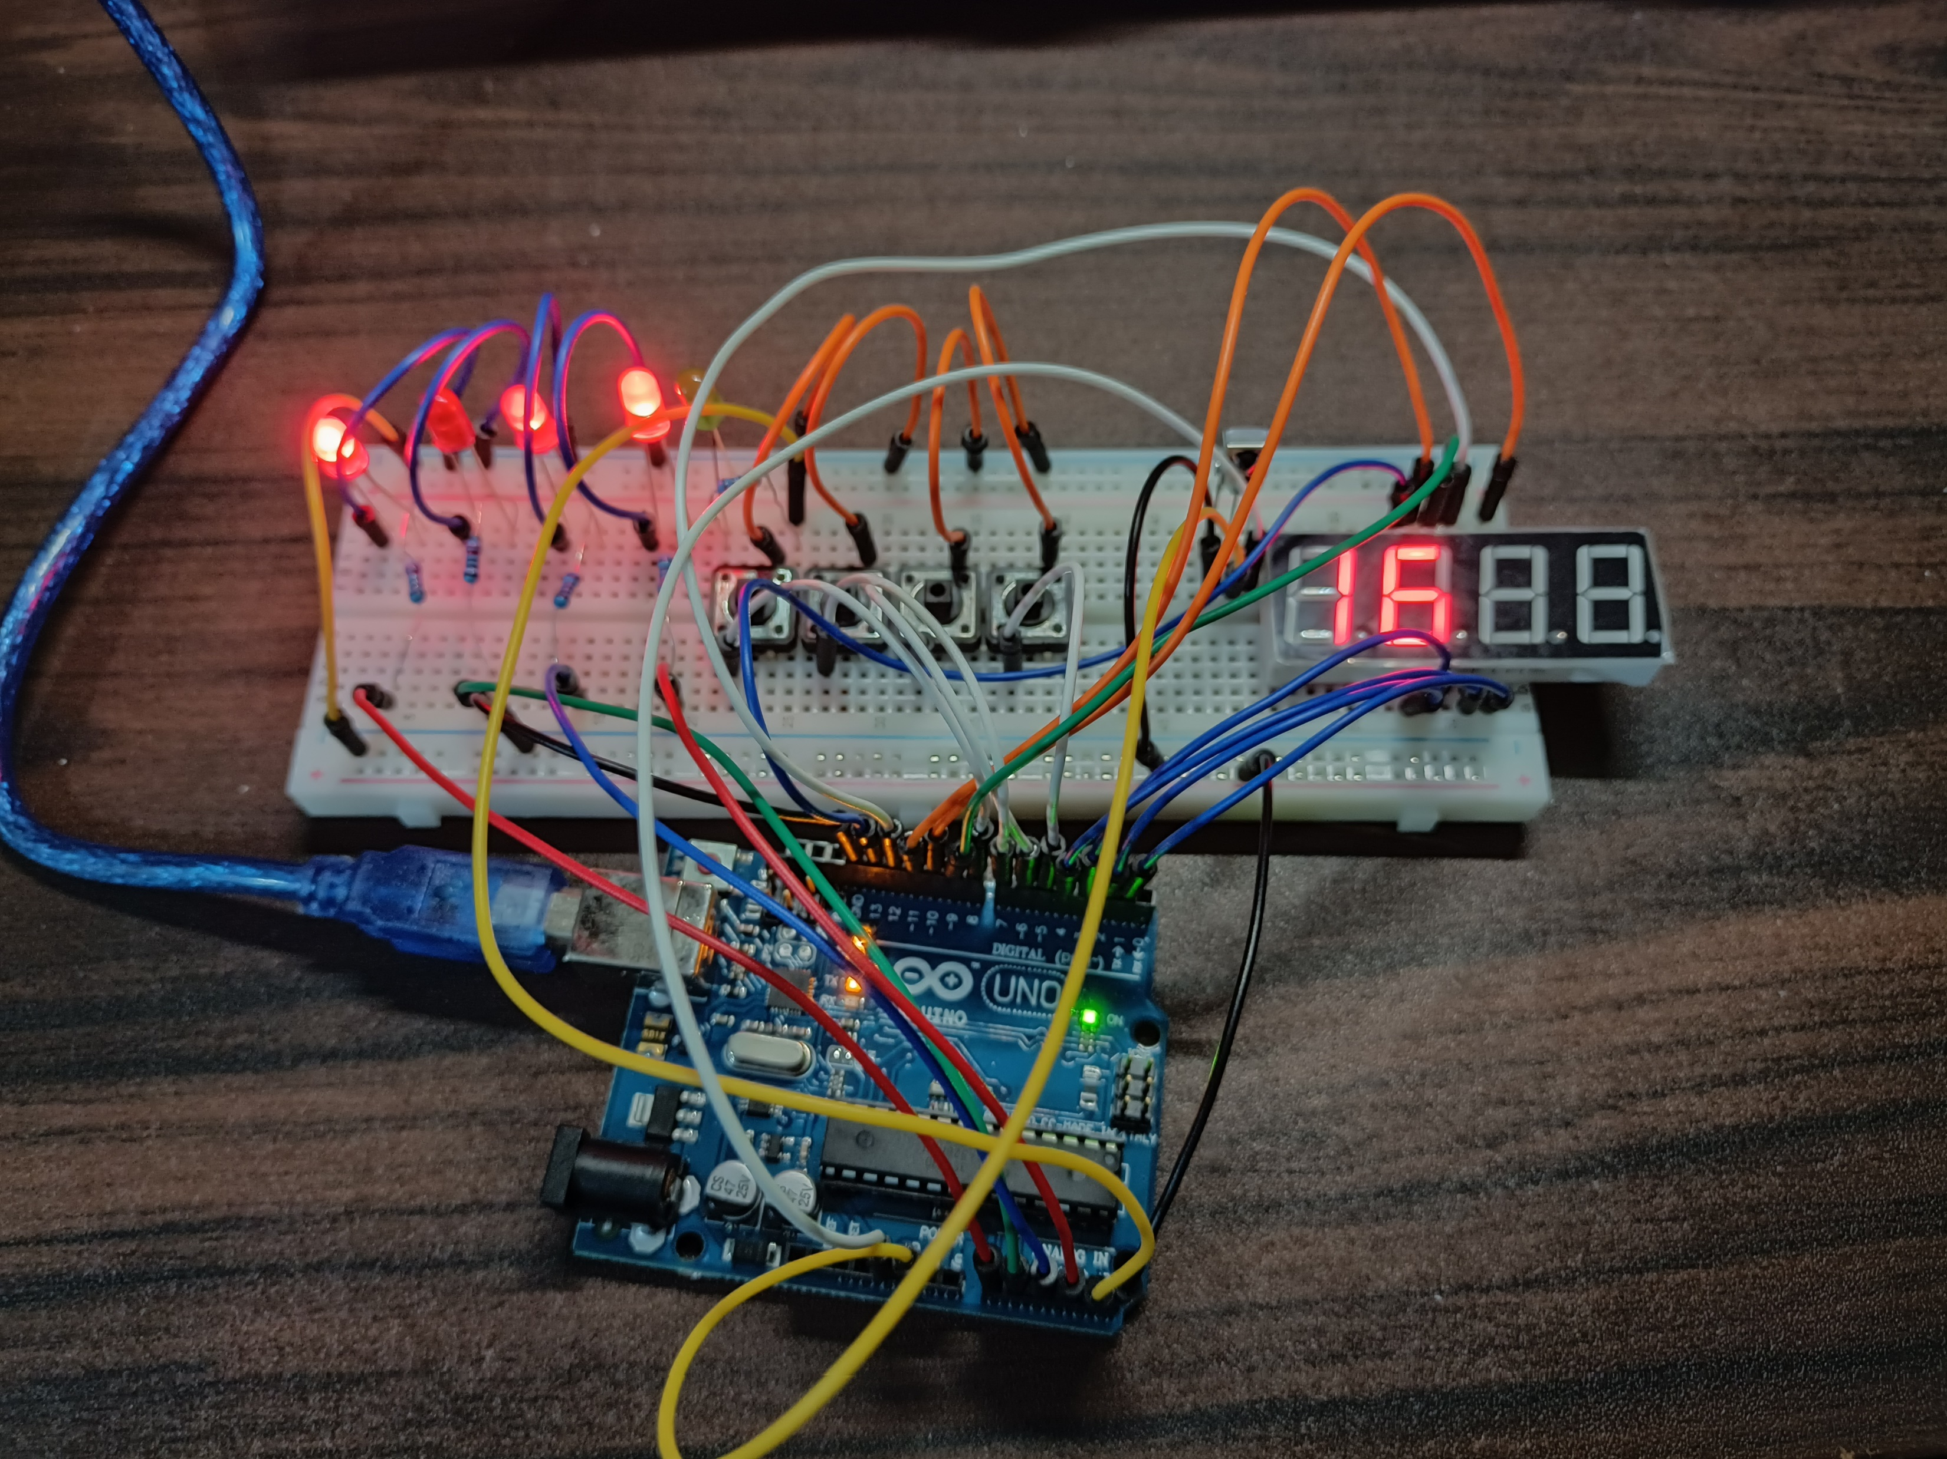
Discussion: 4-Bit Binary to Decimal Form Excess-5
Switch buttons, LEDs, and 7-segment display were used
Inputs are switch buttons: pressed buttons are LOW, unpressed buttons are HIGH
4 switch buttons serve as the 4-bit binary value
Output is in the 7-segment display: conversion of binary to its excess form in decimal
“switch case,” “if-else,” and “analogWrite” were used in changing LED states

Slide 7
Conclusion
Arduino Uno, LEDs, 7-segment display, and switch buttons were properly utilized
Conversion of decimal to 4-bit binary value and 4-bit binary value to excess-5 decimal form were emulated
Lessons from Microprocessors and Logic circuits and Switching theory were applied
Number System Emulator was produced satisfactorily

